Slide 1
CASE Example

Slide 2
Mission Computer
Ground Station
Flight Planner
Waypoint Manager
Flight Controller
Radio
Serial
UAV

Slide 3
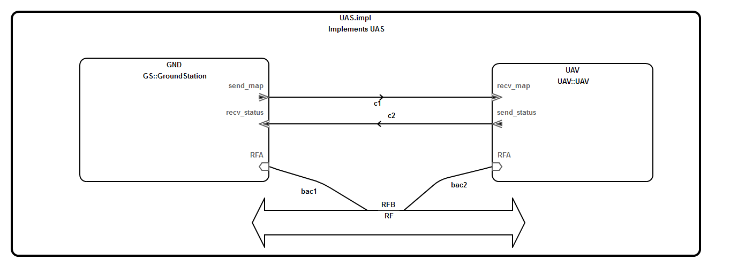
Top Level UAS AADL Diagram

Slide 4
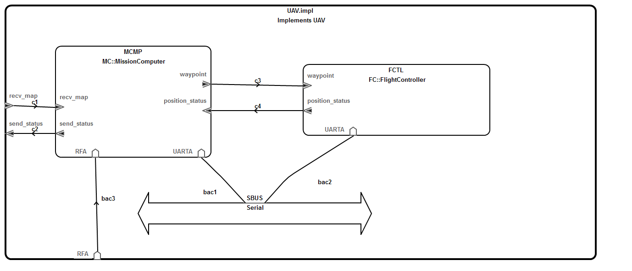
UAV

Slide 5
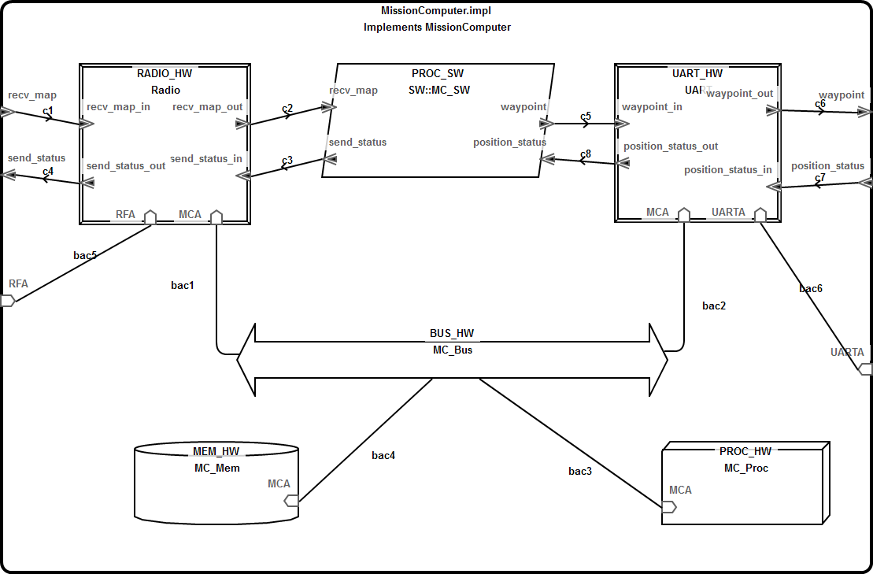
Mission Computer

Slide 6
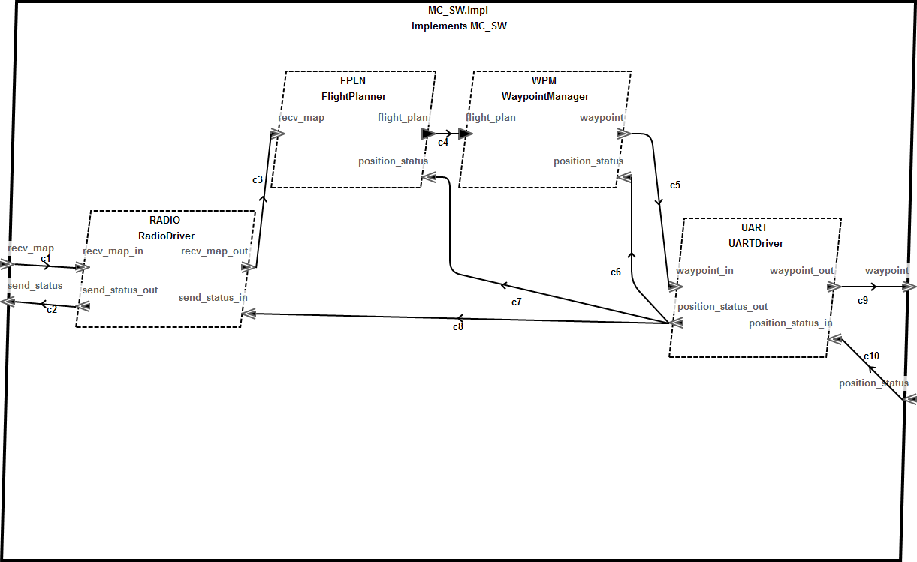
Software

Slide 7
UAV Waypoint Navigation Overview
The Ground Station transmits a map and flight pattern to the UAV
The UAV Mission Computer provides the UAV Flight Controller with a flight mission
The mission consists of a set of waypoints
Waypoints are generated based on map and flight pattern inputs
The UAV navigates from waypoint to waypoint until the mission is complete

Slide 8
Ground Station
The Ground Station transmits a map and flight pattern to the UAV
The map is a geographical region defined by a set of lat-long-alt coordinates
Flight pattern is a behavior the UAV performs within the region (e.g. zig-zag)
The Ground Station must transmit a map and flight pattern before flight
The Ground Station receives position updates from the UAV as it traverses the region

Slide 9
Mission Computer
The Mission Computer:
Receives the map and flight pattern from the Ground Station
Computes the mission
A mission consists of a set of waypoints
Provides mission waypoints to the Flight Controller
The Mission Computer consists of four components:
Radio Driver
Flight Planner
Waypoint Manager
UART Driver

Slide 10
Mission Data
A mission is organized as a linked list of waypoints
Each waypoint element consists of ID, lat-long-alt coordinates, and a pointer to the next waypoint along the path
The last waypoint element of the mission points to itself
Flight Controller memory is limited, so it can only hold a subset (window) of the mission at any given time
The Mission Computer provides the Flight Controller with a window of mission waypoints based on the current position
Notes:
Who selects flight path?

Slide 11
Radio Driver
The Radio Driver encapsulates all functionality required to appropriately pack and unpack messages and communicate with the Ground Station

Slide 12
Flight Planner
The Flight Planner receives a map and flight pattern from the Ground Station (via the Radio driver) and generates a mission.
Once the Flight Planner generates the mission, it is passed to the Waypoint Manager
The Flight Planner also receives position status messages from the Flight Controller (via the UART driver)
The Flight Planner functionality is based on UxAS

Slide 13
Waypoint Manager
The Waypoint Manager receives periodic status messages from the Flight Controller (via the UART driver)
In response to a status message from the Flight Controller, the Waypoint Manager sends the Flight Controller the current mission window (via the UART driver)
The Waypoint Manager sends the next N waypoints whenever the autopilot reaches waypoint N/2
The Waypoint Manager implementation already exists, and will be imported into the project as a legacy code component implemented in C

Slide 14
UART Driver
The UART Driver sends the mission window to the Flight Controller over the serial link
The UART Driver aggregates all packets in a message received from the Flight Controller and combines them before passing to the Waypoint Manager, Flight Planner, and Ground Station (via the Radio driver)

Slide 15
Flight Controller
The Flight Controller takes a mission window as input and uses internal position measurements and navigation logic to direct the UAV from waypoint to waypoint
It provides periodic status messages to the Mission Computer
These messages include the current position and current waypoint ID
The Flight Controller is a third-party component, and therefore black box

Slide 16
Requirements (not exhaustive)
The UAV shall continue to operate if communication with the Ground Station is lost after take-off
If the Flight Planner fails after the initial mission has been generated, the UAV will complete that mission
Completing a mission means reaching the last waypoint in the mission
The UAV shall only accept commands from a legitimate Ground Station
The status of the UAV shall only be read by a legitimate Ground Station
The Ground Station shall only accept status messages from the UAV
The Ground Station will not accept illegitimate status messages
If called, the Waypoint Manager shall output a valid mission window
Well-formed: contain only one cycle (the last element pointing to itself)
Correct size
The Waypoint Manager shall output a mission window in response to a Flight Controller status message
The Waypoint Manager shall respond to a Flight Controller status message before the next Flight Controller status message is received

Slide 17
Waypoint Manager Source
Source
WaypointManager.c
WaypointManager.h
Waypoint.h
Location3D.h
Properties
WaypointManagerFunSpec.thy (Isabelle/HOL theory file)

